Slide 1
[A Part of this presentation is adopted from CS898, University of Waterloo, Canada]
Convolutional Neural Network (CNN)
Md. Golam Rabiul Alam
Associate Professor, BRAC University

Slide 2
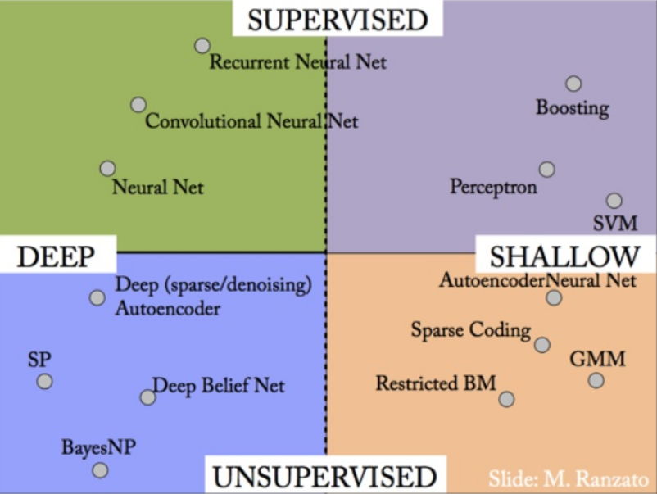
Deep Learning

Slide 3
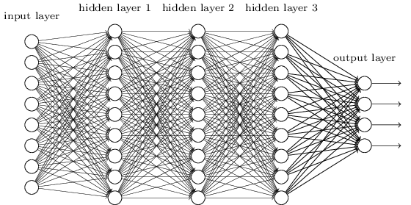
CNN
We know it is good to learn a small model.
From this fully connected model, do we really need all the edges?
Can some of these be shared?

Slide 4
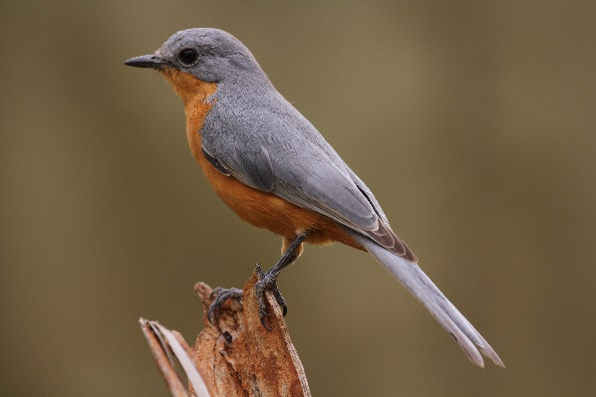
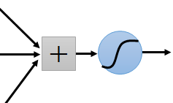
Consider learning an image:
Some patterns are much smaller than the whole image
Can represent a small region with fewer parameters
“beak” detector

Slide 5
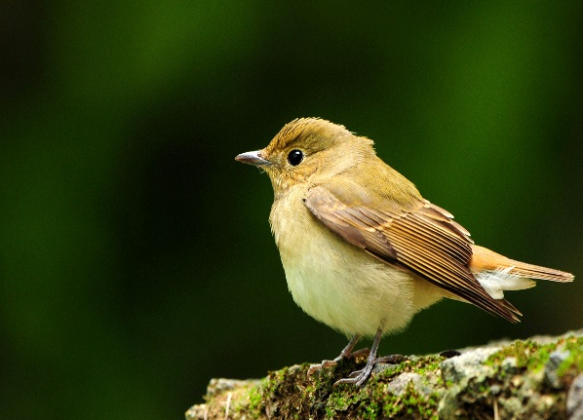
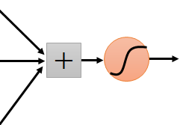
Same pattern appears in different places: They can be compressed! What about training a lot of such “small” detectors and each detector must “move around”.
“upper-left beak” detector
They can be compressed
to the same parameters.
“middle beak” detector

Slide 6
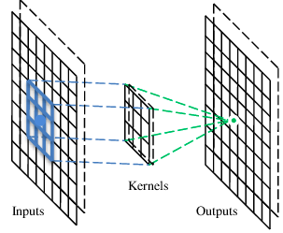
A convolutional layer
A CNN is a neural network with some convolutional layers
(and some other layers). A convolutional layer has a number
of filters that does convolutional operation.
Beak detector
A filter

Slide 7

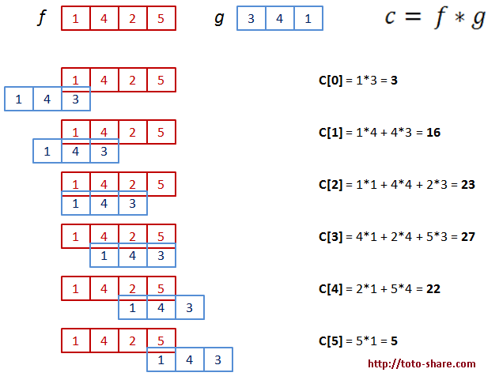
Convolution
The convolution of f and g, written as f ∗ g or f ο g, is defined as the integral of the product of the two functions after one is reversed and shifted

Slide 8
Convolution
These are the network parameters to be learned.
1 | -1 | -1
-1 | 1 | -1
-1 | -1 | 1
1 | 0 | 0 | 0 | 0 | 1
0 | 1 | 0 | 0 | 1 | 0
0 | 0 | 1 | 1 | 0 | 0
1 | 0 | 0 | 0 | 1 | 0
0 | 1 | 0 | 0 | 1 | 0
0 | 0 | 1 | 0 | 1 | 0
Filter 1
-1 | 1 | -1
-1 | 1 | -1
-1 | 1 | -1
Filter 2
……
6 x 6 image
Each filter detects a small pattern (3 x 3).

Slide 9
Convolution
1 | -1 | -1
-1 | 1 | -1
-1 | -1 | 1
Filter 1
stride=1
1 | 0 | 0 | 0 | 0 | 1
0 | 1 | 0 | 0 | 1 | 0
0 | 0 | 1 | 1 | 0 | 0
1 | 0 | 0 | 0 | 1 | 0
0 | 1 | 0 | 0 | 1 | 0
0 | 0 | 1 | 0 | 1 | 0
Dot
product
3
-1
6 x 6 image

Slide 10
Convolution
1 | -1 | -1
-1 | 1 | -1
-1 | -1 | 1
Filter 1
If stride=2
1 | 0 | 0 | 0 | 0 | 1
0 | 1 | 0 | 0 | 1 | 0
0 | 0 | 1 | 1 | 0 | 0
1 | 0 | 0 | 0 | 1 | 0
0 | 1 | 0 | 0 | 1 | 0
0 | 0 | 1 | 0 | 1 | 0
3
-3
6 x 6 image

Slide 11
Convolution
1 | -1 | -1
-1 | 1 | -1
-1 | -1 | 1
Filter 1
stride=1
1 | 0 | 0 | 0 | 0 | 1
0 | 1 | 0 | 0 | 1 | 0
0 | 0 | 1 | 1 | 0 | 0
1 | 0 | 0 | 0 | 1 | 0
0 | 1 | 0 | 0 | 1 | 0
0 | 0 | 1 | 0 | 1 | 0
3
-1
-3
-1
-3
1
0
-3
-3
-3
0
1
3
-2
-2
-1
6 x 6 image

Slide 12
Convolution
-1 | 1 | -1
-1 | 1 | -1
-1 | 1 | -1
Filter 2
stride=1
Repeat this for each filter
1 | 0 | 0 | 0 | 0 | 1
0 | 1 | 0 | 0 | 1 | 0
0 | 0 | 1 | 1 | 0 | 0
1 | 0 | 0 | 0 | 1 | 0
0 | 1 | 0 | 0 | 1 | 0
0 | 0 | 1 | 0 | 1 | 0
3
-1
-3
-1
-1
-1
-1
-1
-3
1
0
-3
-1
-1
-2
1
Feature
Map
-3
-3
0
1
-1
-1
-2
1
3
-2
-2
-1
6 x 6 image
-1
0
-4
3
Two 4 x 4 images
Forming 2 x 4 x 4 matrix

Slide 13
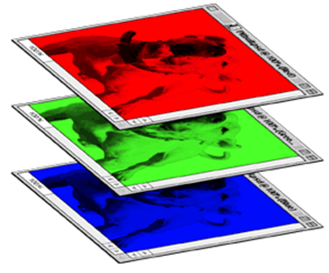
Color image: RGB 3 channels
1 | -1 | -1
-1 | 1 | -1
-1 | -1 | 1
-1 | 1 | -1
-1 | 1 | -1
-1 | 1 | -1
1 | -1 | -1
-1 | 1 | -1
-1 | -1 | 1
-1 | 1 | -1
-1 | 1 | -1
-1 | 1 | -1
1 | -1 | -1
-1 | 1 | -1
-1 | -1 | 1
-1 | 1 | -1
-1 | 1 | -1
-1 | 1 | -1
Filter 1
Filter 2
Color image
1 | 0 | 0 | 0 | 0 | 1
0 | 1 | 0 | 0 | 1 | 0
0 | 0 | 1 | 1 | 0 | 0
1 | 0 | 0 | 0 | 1 | 0
0 | 1 | 0 | 0 | 1 | 0
0 | 0 | 1 | 0 | 1 | 0
1 | 0 | 0 | 0 | 0 | 1
0 | 1 | 0 | 0 | 1 | 0
0 | 0 | 1 | 1 | 0 | 0
1 | 0 | 0 | 0 | 1 | 0
0 | 1 | 0 | 0 | 1 | 0
0 | 0 | 1 | 0 | 1 | 0
1 | 0 | 0 | 0 | 0 | 1
0 | 1 | 0 | 0 | 1 | 0
0 | 0 | 1 | 1 | 0 | 0
1 | 0 | 0 | 0 | 1 | 0
0 | 1 | 0 | 0 | 1 | 0
0 | 0 | 1 | 0 | 1 | 0

Slide 14
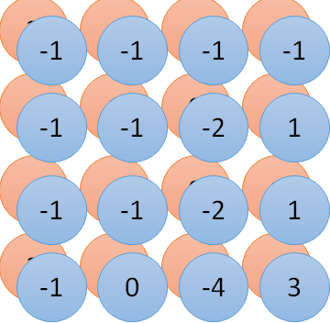
Convolution v.s. Fully Connected
1 | 0 | 0 | 0 | 0 | 1
0 | 1 | 0 | 0 | 1 | 0
0 | 0 | 1 | 1 | 0 | 0
1 | 0 | 0 | 0 | 1 | 0
0 | 1 | 0 | 0 | 1 | 0
0 | 0 | 1 | 0 | 1 | 0
1 | -1 | -1
-1 | 1 | -1
-1 | -1 | 1
-1 | 1 | -1
-1 | 1 | -1
-1 | 1 | -1
convolution
image
1 | 0 | 0 | 0 | 0 | 1
0 | 1 | 0 | 0 | 1 | 0
0 | 0 | 1 | 1 | 0 | 0
1 | 0 | 0 | 0 | 1 | 0
0 | 1 | 0 | 0 | 1 | 0
0 | 0 | 1 | 0 | 1 | 0
Fully-connected
……
……

Slide 15
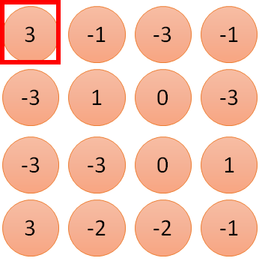
1 | -1 | -1
-1 | 1 | -1
-1 | -1 | 1
1
1
Filter 1
2
0
3
0
3
4:
0
1 | 0 | 0 | 0 | 0 | 1
0 | 1 | 0 | 0 | 1 | 0
0 | 0 | 1 | 1 | 0 | 0
1 | 0 | 0 | 0 | 1 | 0
0 | 1 | 0 | 0 | 1 | 0
0 | 0 | 1 | 0 | 1 | 0
…
0
8
1
9
0
10:
0
…
13
0
6 x 6 image
14
0
fewer parameters!
15
Only connect to 9 inputs, not fully connected
1
16
1
…

Slide 16
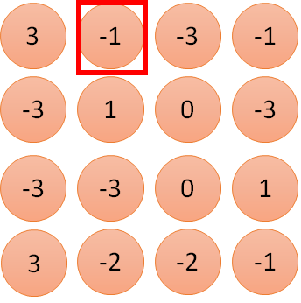
1 | -1 | -1
-1 | 1 | -1
-1 | -1 | 1
1:
1
Filter 1
2:
0
3:
0
3
4:
0
1 | 0 | 0 | 0 | 0 | 1
0 | 1 | 0 | 0 | 1 | 0
0 | 0 | 1 | 1 | 0 | 0
1 | 0 | 0 | 0 | 1 | 0
0 | 1 | 0 | 0 | 1 | 0
0 | 0 | 1 | 0 | 1 | 0
…
7:
0
8:
1
-1
9:
0
10:
0
…
13:
0
6 x 6 image
14:
0
Fewer parameters
15:
1
16:
1
Shared weights
Even fewer parameters
…

Slide 17
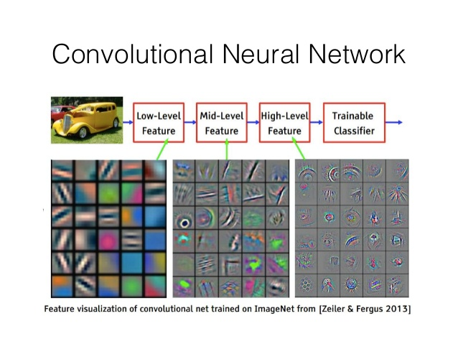
Results of convolution phase

Slide 18
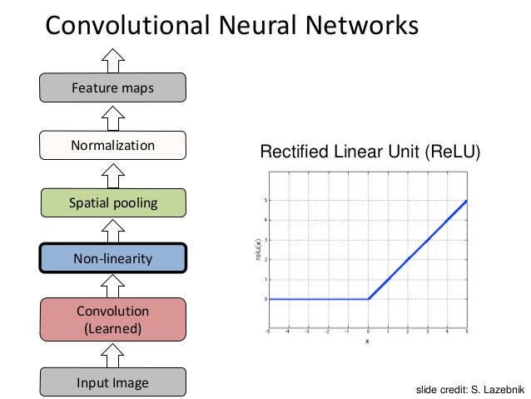
CNN Steps

Slide 19
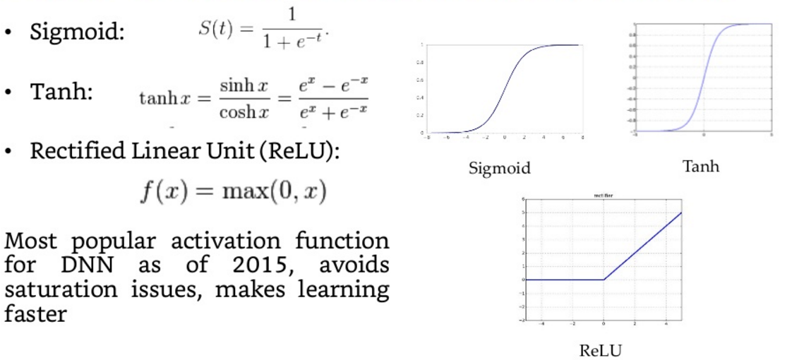
CNN Steps

Slide 20
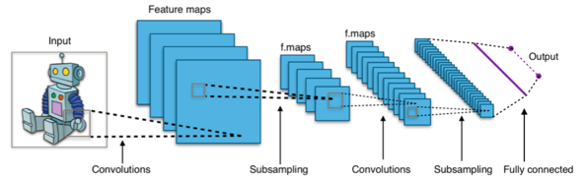
Convolutional Neural Network (CNN : convnet)
INPUT -> FC [a linear classifier]
INPUT -> CONV -> RELU -> FC
INPUT -> [CONV -> RELU -> POOL]*2 -> FC -> RELU -> FC [Here there is a single CONV layer between every POOL layer]
INPUT -> [CONV -> RELU -> CONV -> RELU -> POOL]*3 -> [FC -> RELU]*2 -> FC
First layers of a convnet contains generic features (i.e. edge detectors, etc.) that should be helpful in many tasks. Deeper layers becomes progressively speciﬁc to the details of the classes of the original problem.

Slide 21
Convolution Layer summery
Accepts a volume of size W1×H1×D1W1×H1×D1
Requires four hyperparameters:
Number of filters KK,
their spatial extent FF,
the stride SS,
the amount of zero padding PP.
Produces a volume of size W2×H2×D2W2×H2×D2 where:
W2=(W1−F+2P)/S+1W2=(W1−F+2P)/S+1
H2=(H1−F+2P)/S+1H2=(H1−F+2P)/S+1 (i.e. width and height are computed equally by symmetry)
D2=KD2=K
With parameter sharing, it introduces F⋅F⋅D1F⋅F⋅D1 weights per filter, for a total of (F⋅F⋅D1)⋅K(F⋅F⋅D1)⋅K weights and KK biases.
In the output volume, the dd-th depth slice (of size W2×H2W2×H2) is the result of performing a valid convolution of the dd-th filter over the input volume with a stride of SS, and then offset by dd-th bias.
A common setting of the hyperparameters is F=3,S=1,P=1F=3,S=1,P=1

Slide 22
How convolution works?
Variations in Convolution:
Padding :
Same: Add zero-padding to the image to have the output of the same size as the image, i.e., m x m
Valid: With no zero-padding, kernel is restricted to traverse only within the image, with output size: (m - k + 1) x (m - k + 1)
Full: Add zero-padding to the image enough for every pixel to be visited k times in each direction, with output size: (m + k - 1) x (m + k - 1)
Stride s :
• Down-sampling the output of convolution by sampling only every s pixels in each direction.
• For instance, the output of 'valid' convolution with stride s results in an output of size (m − k + s)/s x (m − k + s)/s

Slide 23
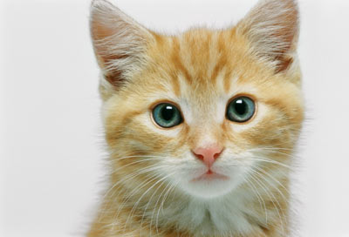
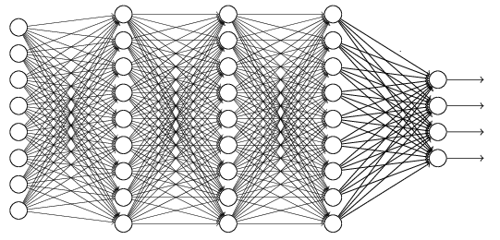
The whole CNN
cat dog ……
Convolution
Max Pooling
Can repeat many times
Fully Connected Feedforward network
Convolution
Max Pooling
Flattened

Slide 24
Max Pooling
1 | -1 | -1
-1 | 1 | -1
-1 | -1 | 1
-1 | 1 | -1
-1 | 1 | -1
-1 | 1 | -1
Filter 1
Filter 2
3
-1
-3
-1
-1
-1
-1
-1
-3
1
0
-3
-1
-1
-2
1
-3
-3
0
1
-1
-1
-2
1
3
-2
-2
-1
-1
0
-4
3

Slide 25
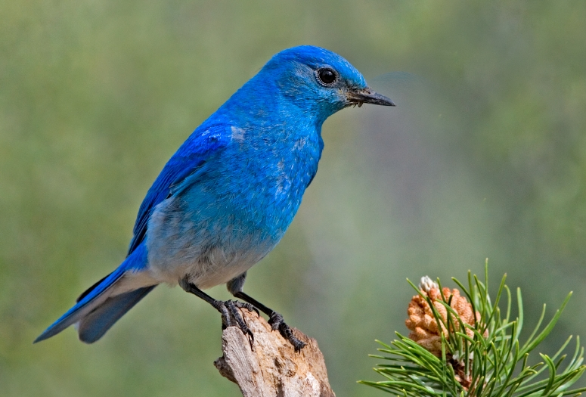

Why Pooling
Subsampling pixels will not change the object
bird
bird
Subsampling
We can subsample the pixels to make image smaller
fewer parameters to characterize the image

Slide 26
A CNN compresses a fully connected network in two ways:
Reducing number of connections
Shared weights on the edges
Max pooling further reduces the complexity

Slide 27
Max Pooling
New image
but smaller
1 | 0 | 0 | 0 | 0 | 1
0 | 1 | 0 | 0 | 1 | 0
0 | 0 | 1 | 1 | 0 | 0
1 | 0 | 0 | 0 | 1 | 0
0 | 1 | 0 | 0 | 1 | 0
0 | 0 | 1 | 0 | 1 | 0
Conv
3
0
-1
1
Max
Pooling
3
1
0
3
2 x 2 image
6 x 6 image
Each filter
is a channel

Slide 28
Pooling Layer Summery
Accepts a volume of size W1×H1×D1W1×H1×D1
Requires two hyperparameters:
their spatial extent FF,
the stride SS,
Produces a volume of size W2×H2×D2W2×H2×D2 where:
W2=(W1−F)/S+1W2=(W1−F)/S+1
H2=(H1−F)/S+1H2=(H1−F)/S+1
D2=D1D2=D1
Introduces zero parameters since it computes a fixed function of the input
For Pooling layers, it is not common to pad the input using zero-padding.
It is worth noting that there are only two commonly seen variations of the max pooling layer found in practice: A pooling layer with F=3,S=2F=3,S=2 (also called overlapping pooling), and more commonly F=2,S=2F=2,S=2. Pooling sizes with larger receptive fields are too destructive.

Slide 29
Pooling layer output size
Depends on your filter size(f) and stride(s), the pooling layer output size will be changed. For example for an input of size W1xH1xC, where W1 is width and H1 is height of the input and C is number of input channel then the output shape would be W2xH2xC,Where:
W2=(W1-f)/s +1
H2=(H1-f)/s+1

Slide 30
The whole CNN
3
0
-1
1
Convolution
3
1
0
3
Max Pooling
Can repeat many times
A new image
Convolution
Smaller than the original image
The number of channels is the number of filters
Max Pooling

Slide 31
The whole CNN
cat dog ……
Convolution
Max Pooling
Fully Connected Feedforward network
A new image
Convolution
Max Pooling
Flattened
A new image

Slide 32
Flattening
3
0
1
3
0
-1
1
3
3
1
-1
0
3
Flattened
1
Fully Connected Feedforward network
0
3

Slide 33


CNN in Keras
Only modified the network structure and input format (vector -> 3-D tensor)
input
Convolution
1 | -1 | -1
-1 | 1 | -1
-1 | -1 | 1
-1 | 1 | -1
-1 | 1 | -1
-1 | 1 | -1
There are 25 3x3 filters.
……
Max Pooling
Input_shape = ( 28 , 28 , 1)
28 x 28 pixels
1: black/white, 3: RGB
Convolution
3
-1
3
Max Pooling
-3
1

Slide 34
CNN in Keras
Only modified the network structure and input format (vector -> 3-D array)
Input
1 x 28 x 28
Convolution
How many parameters for each filter?
9
25 x 26 x 26
Max Pooling
25 x 13 x 13
Convolution
How many parameters
for each filter?
225=
25x9
50 x 11 x 11
Max Pooling
50 x 5 x 5

Slide 35
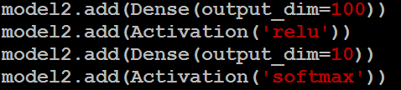
CNN in Keras
Only modified the network structure and input format (vector -> 3-D array)
Input
1 x 28 x 28
Output
Convolution
25 x 26 x 26
Fully connected feedforward network
Max Pooling
25 x 13 x 13
Convolution
50 x 11 x 11
Max Pooling
1250
50 x 5 x 5
Flattened

Slide 36
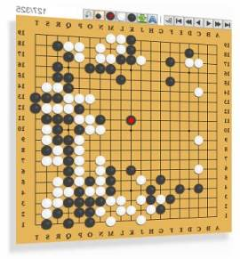
AlphaGo
Neural
Network
Next move
(19 x 19 positions)
19 x 19 matrix
Fully-connected feedforward network can be used
Black: 1
white: -1
none: 0
But CNN performs much better

Slide 37
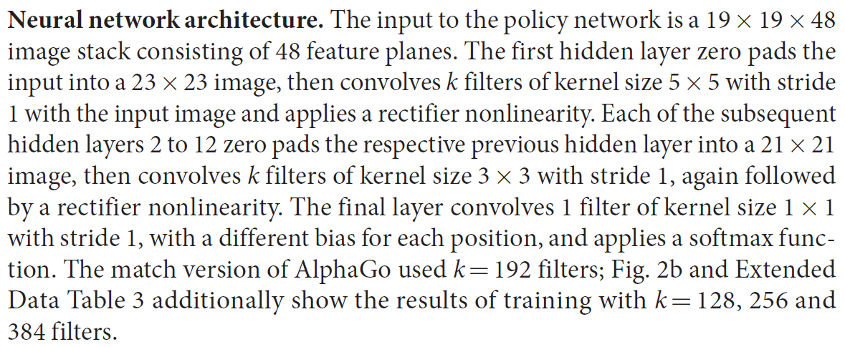
AlphaGo’s policy network
The following is quotation from their Nature article:
Note: AlphaGo does not use Max Pooling.

Slide 38
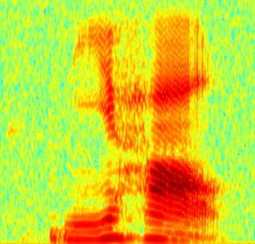
CNN in speech recognition
The filters move in the frequency direction.
CNN
Frequency
Image
Time
Spectrogram

Slide 39
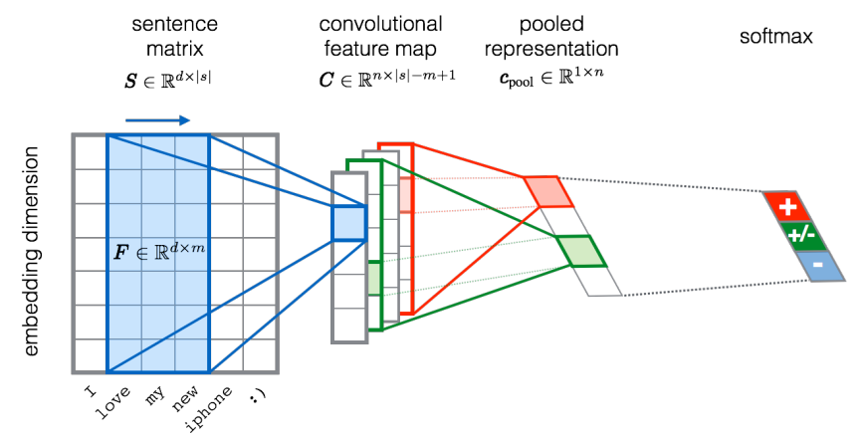
CNN in text classification
?
Source of image: http://citeseerx.ist.psu.edu/viewdoc/download?doi=10.1.1.703.6858&rep=rep1&type=pdf

Slide 40
References
https://medium.com/deep-math-machine-learning-ai/chapter-8-0-convolutional-neural-networks-for-deep-learning-364971e34ab2
http://cs231n.github.io/convolutional-networks/#architectures
https://towardsdatascience.com/understanding-and-calculating-the-number-of-parameters-in-convolution-neural-networks-cnns-fc88790d530d

